Slide 1
Argus Bunker Indexes & Market Coverage
A Singapore perspective
PETCO
Sammy Six
31 May 2022

Slide 2
Argus Media group notices
The Argus Media group (referred to herein as “Argus”) makes no representations or warranties or other assurance, express or implied, about the accuracy or suitability of any information in this presentation and related materials (such as handouts, other presentation documents and recordings and any other materials or information distributed at or in connection with this presentation).
The information or opinions contained in this presentation are provided on an “as is” basis without any warranty, condition or other representation as to its accuracy, completeness, or suitability for any particular purpose and shall not confer rights or remedies upon the recipients of this presentation or any other person. Data and information contained in the presentation come from a variety of sources, some of which are third parties outside Argus’ control and some of which may not have been verified.
All analysis and opinions, data, projections and forecasts provided may be based on assumptions that are not correct or which change, being dependent upon fundamentals and other factors and events subject to change and uncertainty; future results or values could be materially different from any forecast or estimates described in the presentation.
To the maximum extent permitted by law, Argus expressly disclaims any and all liability for any direct, indirect or consequential loss or damage, claims, costs and expenses, whether arising in negligence or otherwise, in connection with access to, use or application of these materials or suffered by any person as a result of relying on any information included in, or omission from, this presentation and related materials or otherwise in connection therewith.
The information contained in this presentation and related materials is provided for general information purposes only and should not be construed as legal, tax, accounting or investment advice or the rendering of legal, consulting, or other professional services of any kind. Users of these materials should not in any manner rely upon or construe the information or resource materials in these materials as legal, or other professional advice and should not act or fail to act based upon the information in these materials.
Copyright notice: Copyright © 2022 Argus Media group. All rights reserved. All intellectual property rights in this presentation and the information herein are the exclusive property of Argus and and/or its licensors and may only be used under licence from Argus. Without limiting the foregoing, you will not copy or reproduce any part of its contents (including, but not limited to, single prices or any other individual items of data) in any form or for any purpose whatsoever without the prior written consent of Argus.
Trademark notice: ARGUS, the ARGUS logo, Argus publication titles, the tagline “illuminating the markets®”, and Argus index names are trademarks of Argus Media Limited. For additional information, including details of our other trademarks, visit argusmedia.com/trademarks.
Notes:
Disclaimer (show briefly)

Slide 3
Content
Argus VWA bunker price assessments’ methodology
Bunker market developments in Singapore from a pricing perspective
Decarbonisation: the road to IMO 2030 and 2050

Slide 4
Methodology

Slide 5
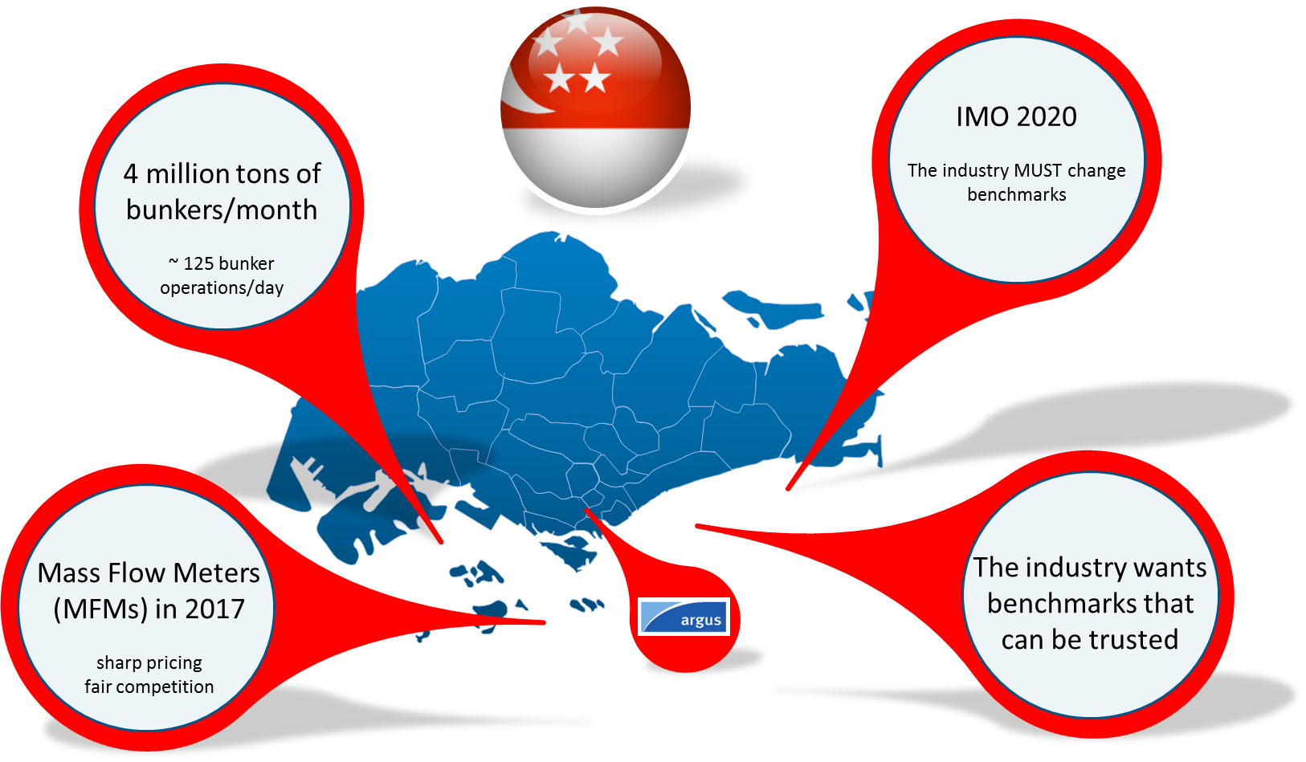
Argus Delivered Bunker Initiative: why Singapore? and why now?
Notes:
Argus focused on Singapore to develop a new bunker methodology because:
It is the world’s largest bunker port, by far (4mn t per month or 50mn t per annum, which is about 25pc of global total). A lot of data is available in the spot market for us to report;
Mass flow meters were made mandatory in 2017 which increased price transparency;
IMO 2020: a new fuel (0.5pc VLSFO) was introduced and needed a benchmark price;
The marine and bunker industry wants price assessments that are transparent, reliable and based on actual market transactions.

Slide 6
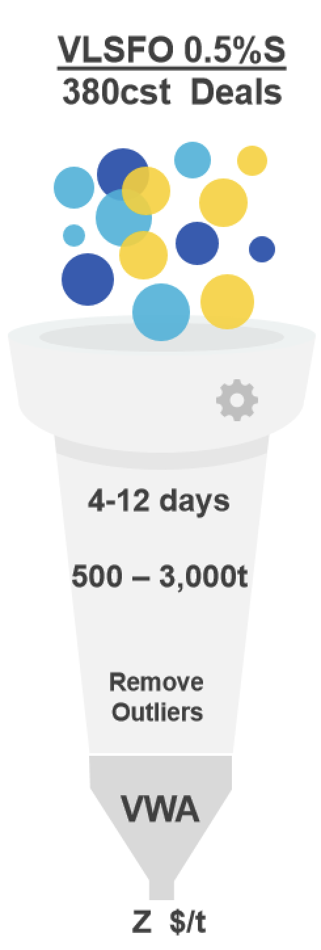
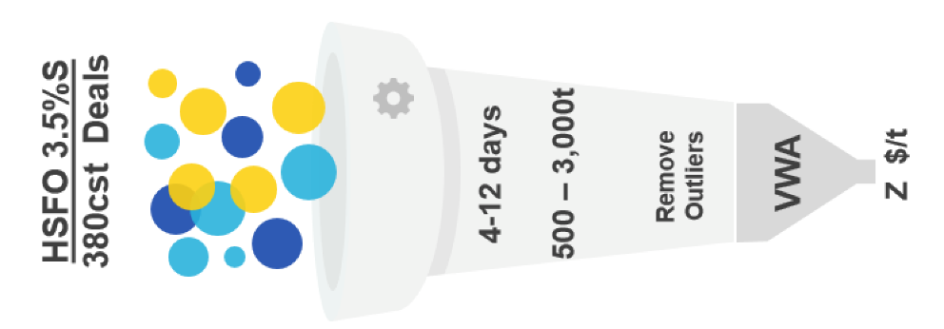
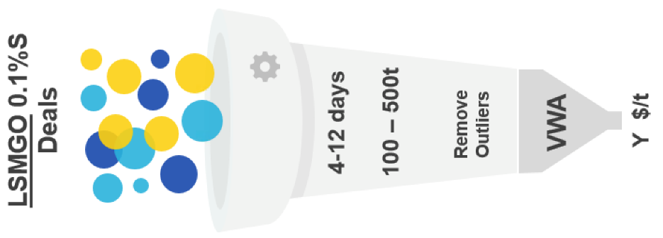
Assessments based on Volume Weighted Averaging (VWA) of deals
Notes:
Argus Bunker Indexes in Singapore are based on a Volume Weighted Average of reported deals that meet the following criteria:
HSFO and VLSFO: 500 – 3,000t and MGO: 100-500t for delivery 4-12 days from the trade date
We remove price outliers which we define as reported deals that are $4 above or below all deals that meet the standard parameters
A VWA is then calculated of the remaining deals, and those are our price assessments.

Slide 7

Deals must be received by 7pm Singapore time to be included
Deals are preferred by email to singaporebunkers@argusmedia.com
but can be submitted by any reasonable means including phone, skype, ICE chat, text, WhatsApp etc.
Deal information is treated as strictly confidential. Only the quantity of deals and the assessed price are published.
Notes:
See text above.

Slide 8
Singapore: average reported deals reported to Argus, per day and by grade
Notes:
Argus started reporting bunker deals in Singapore from June 2018 onwards;
On average, we now report between 10-15 deals per day, depending on spot market activity;
Most of the deals before IMO 2020 were HSFO, afterwards this changed to a majority being VLSFO (now about two-thirds of deals received);
This is a representative share of the spot market, which allows our assessments to be an accurate reflection of value on any given trade date.

Slide 9
Cumulative numbers of companies submitting deals (left) & by type of company (right) to Argus
65
Notes:
Only a handful of companies submitted deals to Argus when we launched this initiative in June 2018;
A total of 55 companies have now submitted deals to us (cumulatively) or about 6-10 individual companies every day;
In terms of type of companies, we receive about 50pc of deals from suppliers, 20pc from traders, 20pc from ship owners (buyers) and 10pc from brokers (based in Singapore and London);
A wide variety of submitters ensures that our assessments cannot be dominated by any one company.

Slide 10
Average daily deals reported to Argus, East of Suez
Notes:
We now also base our bunker assessments in other ports in Asia on a VWA methodology;
After Singapore, we added Fujairah, then China (Zhoushan, Shanghai and Hong Kong), Japan and we now also receive deal information for South Korean ports (Busan, Ulsan and Yosu);
On average, Argus reports between 35-40 spot deals each day in Asia.

Slide 11
Market developments

Slide 12
Key bunker grades in Singapore ($/t)
Notes:
Substantial run-up of outright prices since the past half year, in line with crude
LSMGO spike: shortage of diesel due to Russian sanctions
Past month (May): shortage of VLSFO cargo into SG

Slide 13
Delivered premiums ($/t)
Notes:
HSFO spike March-April 2022: due to contamination crisis
VLSFO spike May 2022: due to severe cargo shortage

Slide 14
Scrubber or Hi-5spread, Singapore, VLSFO minus HSFO ($/t)
Notes:
- At record levels now again due to shortage of VLSFO and abundance of HSFO, not seen since 2 January 2020 (IMO 2020 sulphur cap)

Slide 15
Decarbonisation

Slide 16
What are IMO’s GHG reduction targets?
Notes:
IMO 2020: sulphur reduction (only two options: keep burning HSFO and install scrubber or burn VLSFO) Transition overshadowed by Covid-19…
IMO 2030 & 2050: GHG emissions reduction (many options)

Slide 17
Are IMO’s emissions goals set too low?
  Examples of ship owners who have already achieved IMO’s 2030 goals
Ship owner | CO2 emissions down from 2008 levels | Years ahead of IMO 2030 | Approach to CO2 reduction | Approximate yearly fuel burn, million mt
Maersk | 46.3% by 2020 | 10 | Reduced speed, improved vessel efficiency, use of biofuels. Experimenting with bio-methanol, e-methanol, lignin fuels and green ammonia. Will not be pursuing LNG | 10-12
CMA CGM | 49% by 2020 | 10 | Reduced speed, LNG and bio-methane | 7.5-8
Hapag Lloyd | 50% by 2019 | 11 | Reduced speed, LNG and minimizing water resistance on its vessels' hulls | 4-5
Yang Ming | 51% by 2019 | 11 | Reduced speed, replacing vessels over 20 years of age with newer, more efficient vessels and reducing its vessels speeds. Also installed a monitoring system to manage fuel consumption, and considering the possibility of installing LNG dual-fuel engines | 1.6+
Notes:
Some environmental groups have said that the IMO has set their CO2 emissions goal posts very low.
The IMO is generously asking for 40% CO2 emissions reduction by 2030 from 2008 base levels. That 22 years. In 22 years, this goal is easily achievable, just based on using more fuel-efficient vessel engines that give the shipowner more miles per gallon.
Besides technological improvements, a simple way for a ship owner to drop their emissions is simply to reduce their speed. The slower the vessel moves, the less fuel it burns.
This is a list of some of the biggest container ship companies in the world
These companies managed to surpass IMO’s 2030 goals in 2019 and 2020, 10-11 years ahead IMO’s schedule.
A thing to highlight is that not all shipping companies have achieved IMO’s 2030 goals yet. The companies listed here are some of the biggest in the industry and in good financial standing, so they can afford the latest model ships with the most efficient engines.
You can see from the table what is the approach to reducing CO2 the companies have taken.
Some of these are considering biomethanol, green ammonia, LNG, etc.

Slide 18
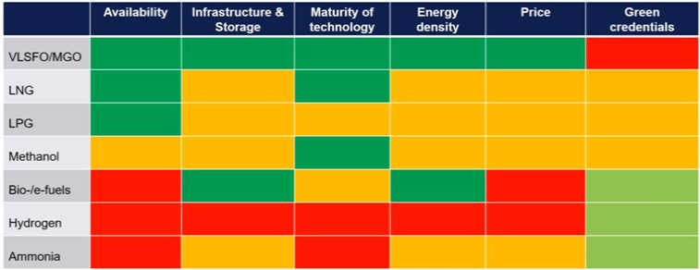
Different fuels have different trade-offs
The picture as of now
Source: DNV
Notes:
Methanol uses: plastics, paints, car parts and construction materials. Similar to marine gasoil bunkering, but challenges regarding toxicity and in firefighting. Methanol is mainly produced from natural gas but could also be done from green hydrogen combined with CO2
Ammonia uses: mainly fertilizer. Challenges to use it as fuel include low flammability, high NOx emission and low radiation intensity. To achieve optimum combustion, ammonia bunkers are likely to be blended with 5% MGO
Hydrogen uses: refining, treating metals, fertilizer, rocket fuel. But needs ‘fuel to make fuel’ and suffers from low energy density

Slide 19
Alternative marine fuels: comparing prices apples to apples
Heat content conversion factors in million British thermal units per metric ton
VLSFO | 39.3-42.1 (varies depending on blend)
MGO | 40.4-43.5 (varies depending on blend)
Ammonia (green and grey) | 17.6
Methanol and bio-methanol | 18.9
Bio-diesel | 31.3
LNG | 52.2
Hydrogen | 113.70
VLSFO, MGO and “alternative” marine fuels have different heat contents (in BTUs).
1 mt of VLSFO has:
2.2 times more heat content than 1mt ammonia
2.1 times more heat content than 1mt of methanol
1.3 times more heat content than 1mt of biodiesel
Notes:
Different fuels have different heat (or energy content), which is measured in British Thermal Units., or BTUs.
In order to compare fairly, apples to apples, prices of alternative and conventional marine fuels, we take into consideration their heat contents.
For example
1 mt of methanol has less than half the heat content of 1 metric ton of VLSFO.
Biodiesel’s heat content is closer to that of VLSFO.
LNG and hydrogen, on a metric ton basis actually have higher heat content than VLSFO.

Slide 20
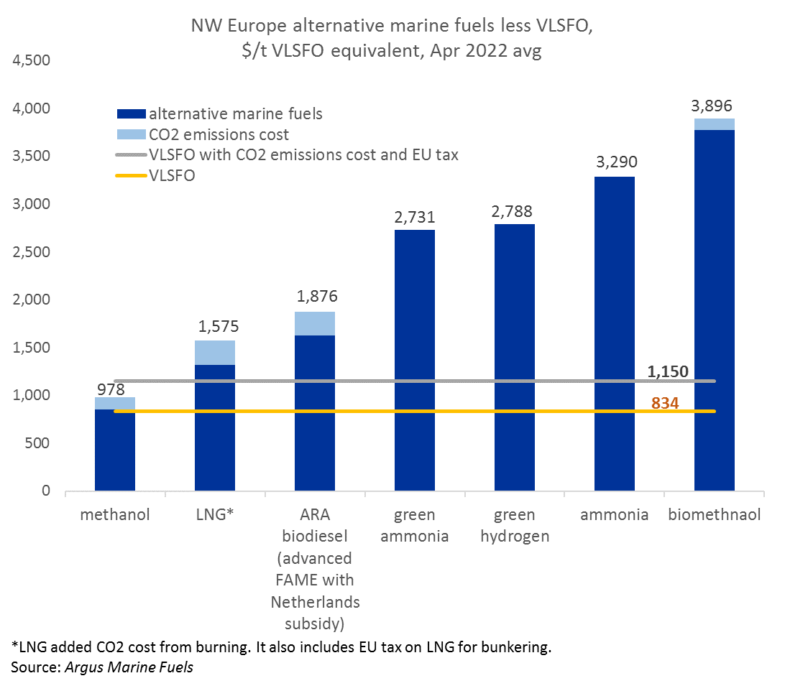
Methanol best positioned to compete with VLSFO
Notes:
The orange horizontal line shows the outright price of VLSFO.
The grey horizontal line shows the VLSFO price with added CO2 cost and added fuel oil tax.
The bars show prices of the different alternative fuels with added CO2 cost.
Ammonia does not emit CO2 when burned so no CO2 cost there.
I should point out that in light of Russian sanctions, the European spot methanol barge market is seeing requests for non-Russian methanol. Russia makes about 4mn t methanol per year, consumes 2-2.5mn t domestically and exports about 1.5mn t or so. Most of it goes to Europe. Total world demand for methanol outside Russia is 85mn t.
Fundamentally, there is ample methanol to go around, it will just have to shift trade patterns.
For those of you interested in methanol coverage I would highly recommend you looking into the Argus Methanol report.

Slide 21
Singapore: betting on several horses
Overview of low-carbon fuels and initiatives
Alternative fuel | Timeline | Initiatives
LNG | Current | Pilot Project (MPA), supply licenses (3), LNG bunkering infrastructure, LNG bunkering vessel (FueLNG Bellina)
Biofuels | Short-Medium term | Biofuel trials by industry, supported by MPA
Ammonia | Long term | MPA joins The Castor Initiative, MoU to study development of green ammonia ship-to-ship supply chain
Methanol | Long term | NTU study with Methanol Institute
Hydrogen | Long term | Part of wider hydrogen economy transformation, trial of hydrogen fuel cell for ships
Other initiatives: Global Centre for Maritime Decarbonisation (GCMD), discounts on taxes and fees for green ships (GSP), maritime decarbonisation blueprint
Notes:
LNG bunkering
When talking about Singapore in a context of alternative marine fuels, LNG bunkering has so far played a key role. The city state has in recent years invested significantly in LNG bunkering hardware, and it has indicated decisively that it will continue to do so in the future. This is in itself significant, given the recent backlash against LNG. As Jonty stated earlier on, LNG is mainly seen as a transition fuel, as it can only reduce CO2 emissions by about 20pc compared to conventional bunker fuel. Plus there’s the issue of methane leakage.
Despite this, Singapore emphasizes pragmatism first and foremost. It acknowledges that LNG is readily available and cost effective. LNG should be seen as part of an ‘all of the above’ approach and usage of the ultra-chilled fuel should not be seen as mutually exclusive relative to the other options. Rather, LNG can be used now to make progress in lowering emissions, with other fuels such as ammonia, hydrogen and biofuels playing a role later, as more time is needed to develop them in terms of availability, scalability and affordability.
This all makes sense especially given Singapore’s long term ambition to develop into a key physical trading hub for LNG. Singapore completed an LNG terminal in Jurong Island in 2013, and its main uses involve storage and reloading services. Remember that Singapore depends on natural gas for about 80pc of its electricity needs and therefore LNG imports help with reducing the country’s reliance on piped imports from neighboring Indonesia and Malaysia.
So LNG bunkering makes a lot of sense here. Over the past years, the Maritime and Port Authority has taken several measures to stimulate the adoption of LNG bunkering. For example, it launched a Pilot Project that included a co-funding programme to build LNG-powered vessels; a waiver of craft dues for LNG-fueled harbour craft; port dues incentives; a technical reference for LNG bunkering (TR 56) and a Memorandum of Understanding with other ports around the world to share best practices.
Singapore is quite ambitious regarding LNG bunkering, as it is targeting a total capacity of 1 million tonnes by the end of 2021. For that to happen, LNG bunkering infrastructure is getting expanded mainly by three companies: Keppel, Shell and FueLNG. FueLNG is one of the three officially licensed LNG bunker suppliers in Singapore, together with Pavilion and since recently, Total.
In March this year, an important milestone was reached when the first LNG bunkering vessel, the FueLNG Bellina, started operations. It was the first time a vessel-to-vessel operation was carried out in Singapore. Before that, ships received LNG via trucks, which was much less efficient and way more expensive. So far, one containership and one oil tanker have received LNG from the Bellina, with FueLNG planning for 30 to 50 refueling operations by the end of this year.
In the region, it’s not just Singapore that is making progress regarding LNG bunkering. In Malaysia, Petronas and Jera are setting up an LNG bunkering network as well, meaning that we can expect competition to intensify.
Now, let’s turn our attention to some of the other fuels.
Biofuels
The next best alternative, apart from LNG, is likely drop-in biofuels. The MPA here has yet to announce mandates and incentives regarding biofuels, but it is supporting industry in making the fuel more accessible.
In April this year, Singapore was home to the first biofuel trial for an ocean-going vessel. The trial was carried out by BHP, Oldendorff and Dutch biofuels producer GoodFuels. GoodFuels supplied the vessel, on her way to Europe from Australia, with a blend of conventional marine fuel and used cooking oil. Also in April this year, the MPA and Japanese trading company Toyota Tsusho announced they would be cooperating on a bunker biodiesel trial. The MPA has been working on supporting biofuels trials as far back as 2017, when it started discussions with BHP and GoodFuels.
Japanese container liner Ocean Network Express, or ONE, in March and April this year, also conducted trials of sustainable marine biofuel. The fuel was also provided by GoodFuels but the trials took place in Rotterdam instead of Singapore.
Ammonia
Next in line, then, would be ammonia, which is at the moment predominantly used in agriculture as fertilizer. Earlier this year, the MPA announced it had joined The Castor Initiative, which is a collection of shipping and technology companies that are planning to develop ammonia-powered tankers.
The MPA joined the coalition because it wants to lend its expertise as port operator of the world’s largest bunkering hub, and it will also support the adoption of ammonia as marine fuel via research.
In terms of infrastructure, Maersk, Keppel, Fleet and some other companies, in March this year inked a Memorandum of Understanding to study setting up a green ammonia, ship-to-ship supply chain for bunkering in Singapore. Maersk has been quite vocal about supporting ammonia and methanol over for example LNG bunkering, as their preferred bunker fuels of the future.
Methanol
Speaking of methanol, also here Singapore is taking an interest. In January 2019 the Nanyang Technological University launched a study together with the Methanol Institute, to evaluate methanol as a bunkering fuel. No plans have been made, however, to develop infrastructure in the port to support methanol bunkering.
Hydrogen
And then lastly, a few words about hydrogen. Singapore is actually studying how to transform its economy into one powered by hydrogen. It has set an ambitious goal to halve its peak greenhouse gas emissions by 2050, and hydrogen is anticipated to play a major role in reaching that goal. Hydrogen is expected to mainly play a role in the power generation sector as well as in transport. It would be reasonable to expect that hydrogen would then also gain adoption in the bunkering sector.
Singapore is following in the footsteps of China, Japan and South Korea, who all have begun paving the way to a hydrogen-powered future.
One more concrete development here is that Shell announced in March this year that it will trial hydrogen fuel cells for ships in Singapore. The oil major said that it will begin doing so with a RoRo vessel in 2022.
Summary
In summary, Singapore is betting on several horses at the same time but it is prioritizing LNG bunkering in the short term. In the mid-term, it believes biofuels will play a larger role and it is rooting for ammonia, hydrogen and methanol in the longer term.

Slide 22

Sammy Six
Deputy Editor, Marine Fuels
sammy.six@argusmedia.com
+971 525 129944
Dubai
www.argusmedia.com

